Slide 1
UML DIAGRAM VERSION 2.0 [DRAFT 1]
= ACTOR
= ACTION
LOGOUT
USER
GUI
MODIFICATION
OF
LOCATIONS
LOGIN
ADMIN
GOOGLE EARTH
ROUTE CALCULATIONS
DISPLAY SHORTEST ROUTE

Slide 2

UML DIAGRAM VERSION 2.0
[LOGIN DIAGRAM]
[USER]→
LOGIN
[ADMIN]→
PROMPT FOR USERNAME
PROMPT FOR PASSWORD

Slide 3
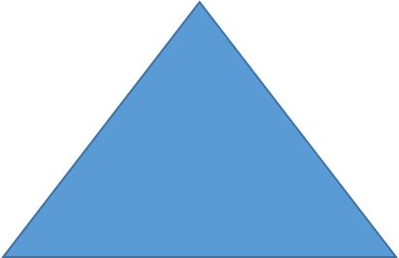
UML DIAGRAM VERSION 2.0
[MODIFICATIONS OF LOCATIONS DIAGRAM]
USER
ADD STARTPOINT LOCATION
ADD
ADD LOCATION(S)
ADD ENDPOINT LOCATION
CHANGE STARTPOINT LOCATION
EDIT
CHANGE LOCATION(S)
DELETE STARTPOINT LOCATION
CHANGE ENDPOINT LOCATION
DELETE
DELETE LOCATION(S)
DELETE ENDPOINT LOCATION
ADMIN

Slide 4
UML DIAGRAM VERSION 2.0
[ROUTE CALCULATIONS]
CALCULATE SHORTEST DISTANCE
CALCULATE SHORTEST TRAVEL TIME
DISPLAY SHORTEST DISTANCE
DISPLAY SHORTEST TRAVEL TIME

